Slide 1
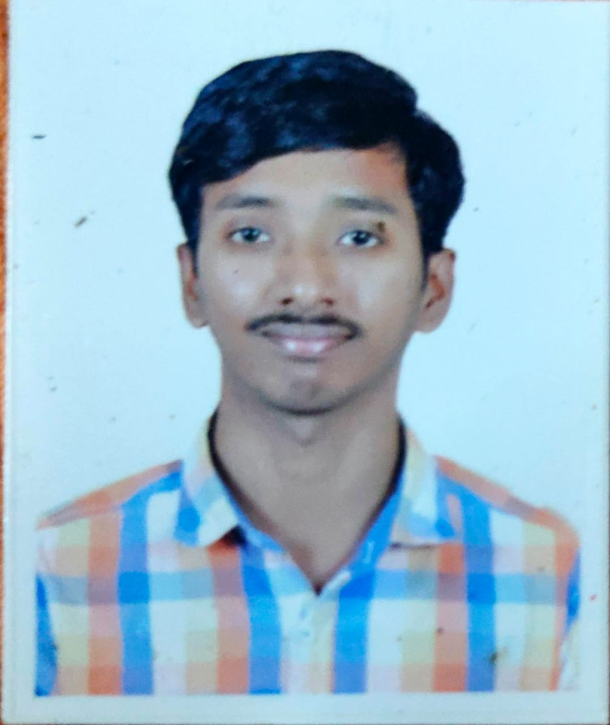
Pavan Kumar Buragadda pavan_buragadda@persistent.com
Profile Summary
8 years of experience in oracle database administration and AWS cloud.
Experience on oracle to aws aurora postgresql migration.
Good Knowledge in AWS tools like AWS SCT, ora2pg and DMS.
Experience on oracle to aws rds oracle migration.
Good Knowledge in AWS .
Supported mission critical Production and non-production databases.
Proficient in database builds in production and non-production environment.
Good knowledge on Database Patching Activities.
Key Skills and Knowledge
Oracle dba
Oracle RAC
shareplex
AWS
Dataguard
OS
Linux
Educationk;oi9y6h,.
RMK Engineering College
Sep 2008- June 2012
Bachelor of Engineering - BTech
Work Experience
Persistent Systems Ltd - Jan 2023 to Till Date [Senior Engineering Lead]
Netcracker Technology Ltd - Oct 2021 to Dec 2022 [Senior Technology Engineer]
Verizon - Feb 2016 to Oct 2021 [Eng 111 – Database Admin ]
Mphasis – Aug 2014 to Dec 2016 [ IT Specialist ]

Slide 2
Project Details
Project: Globe Telecom
Description: This project is a billing software
Client: Globe Telecom
Organization: Netcracker
Duration: Oct 2021 to Dec 2022
Responsibilities:
Oracle migration and 19c upgrades.
Tools & Technologies: oracle, Openstack cloud,weblogic
Project: Sabre Holdings
Description: This project based on Airlines and more
Client: Sabre Holdings
Organization: Mphasis
Duration: Aug 2014 to Dec 2016
Responsibilities:
Oracle migration and 12c upgrades
Export and Import
Applying latest Patches
Tools & Technologies: oracle, Dataguard , RAC
Project: Verizon Wireless
Description: This project is based on telecommunications
Client: Verizon
Organization: Verizon
Duration: Feb 2016 to Oct 2021
Responsibilities:
migration to cloud AWS
Oracle to postgresql migrations
AWS DMS and ora2pg knowledge
Oracle migration and 12c upgrades
Export and Import
Applying latest Patches
Tools & Technologies: AWS, oracle.

